Slide 1

Products and Services

Slide 2
The Total Product
Product
quality
Physical
characteristics
of goods
Seller’s
services
Seller’s
reputation
Price
Colour
Brand
Product
warranty
Packaging
Design

Slide 3

Types of consumer products
Convenience
product
Relatively inexpensive – merits little shopping effort
Shopping
product
Requires comparison shopping – usually more expensive and found in fewer outlets
Specialty
product
Extensive consumer search – buyer is reluctant to accept substitutes
Unsought
product
Product unknown or a known product that the buyer does not actively seek

Slide 4
Product line, width and depth
1 2 3 4 5 6
Coffee
Instant
Width of product mix
Depth of mix
Ground
Bags
Beans

Slide 5
Product line, width, depth explanation
Product mix/assortment = all products company makes
Product line = group of closely related items
Depth of mix = assortment of items in each product line
Width of mix = number of product lines carried

Slide 6
Product class, categories, brands
Product class = Automobiles
Product categories = vans; cars; lorries; large or small vehicles; etc
Product brands = Ford; Toyota; Nissan; Renault; Jaguar

Slide 7
The Product Life Cycle
Development
Growth
Maturity
Saturation
Decline
Introduction
Sales
Cash + ve
0
Profit/loss
Cash - ve
Scale break

Slide 8

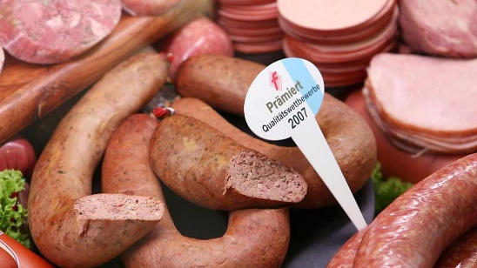

New Product Development
Innovative products – truly unique. Still to be developed products in this category might be a cure for cancer. Any such new product satisfies a real need that is not being satisfied at the time it is introduced
Replacement products – are significantly different to existing products in terms of form, function and benefits. e.g. Johnson & Johnson Acuvue disposable contact lenses
Imitative products (sometimes called ‘me too’ products) – might be new to a particular company, but not new to the market. e.g. cold and cough cure remedies and detergent manufacturers routinely introduce ‘new’ products that are imitations of existing products

Slide 9
Diffusion of
% first time adopters
Innovators Early Early Late Laggards
(2.5%) adopters majority majority (16%)
(13.5%) (34%) (34%)

Slide 10
Types of purchaser
Innovators: Adventurous; purchase early as it is exciting
Early adopters: Opinion leaders; purchase after analysis but willing to take reasonable risk
Early majority: Deliberate masses; try after respected people have tried it. Need to be infected with the idea
Late majority: Sceptical masses; try after respected people have proven it; need time to think
Laggards: Most traditional of all; no urgent reason to change

Slide 11
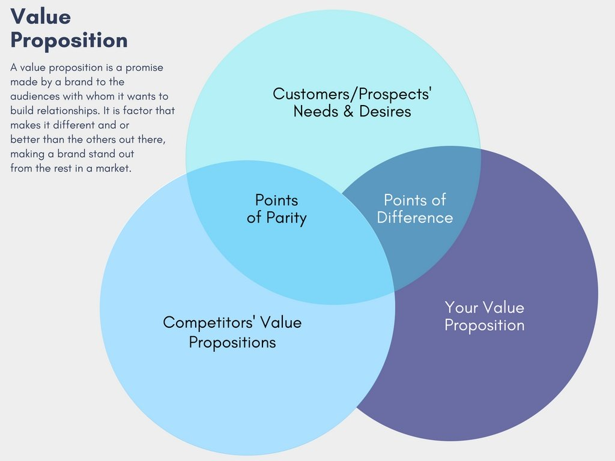
Value analysis/Value engineering
VA/VE follows a structured thought process to evaluate options:
Gather information 1.What is being done now? Who is doing it? What could it do? What must it not do? Measure 2.How will the alternatives be measured? What are the alternate ways of meeting requirements? What else can perform the desired function? Analyse 3.What must be done? What does it cost? Generate 4.What else will do the job? Evaluate 5.Which Ideas are the best? 6. Develop and expand ideas What are the impacts? What is the cost? What is the performance? 7.Present ideas. Sell alternatives.

Slide 12


Services
Task performed for customer or activity involving customer participation e.g. gardening, meal at restaurant, lecture
Characteristics:
Intangibility – customer cannot see or sense product so marketer has to sell a promise: difficult to advertise or display (associate with a tangible product)
Perishability – product cannot be stored e.g. airline flight or hotel room and unused capacity is lost for ever (use forecasting)
Inseparability – buyer and seller must be present for exchange to occur as services are difficult to distribute (have multiple locations)
Heterogeneity – quality of delivered service can vary widely (standardise service)
Success depends on keeping customers satisfied long term; generating repeat business is challenging; relationship marketing becomes critical so high levels of training and motivation required

Slide 13
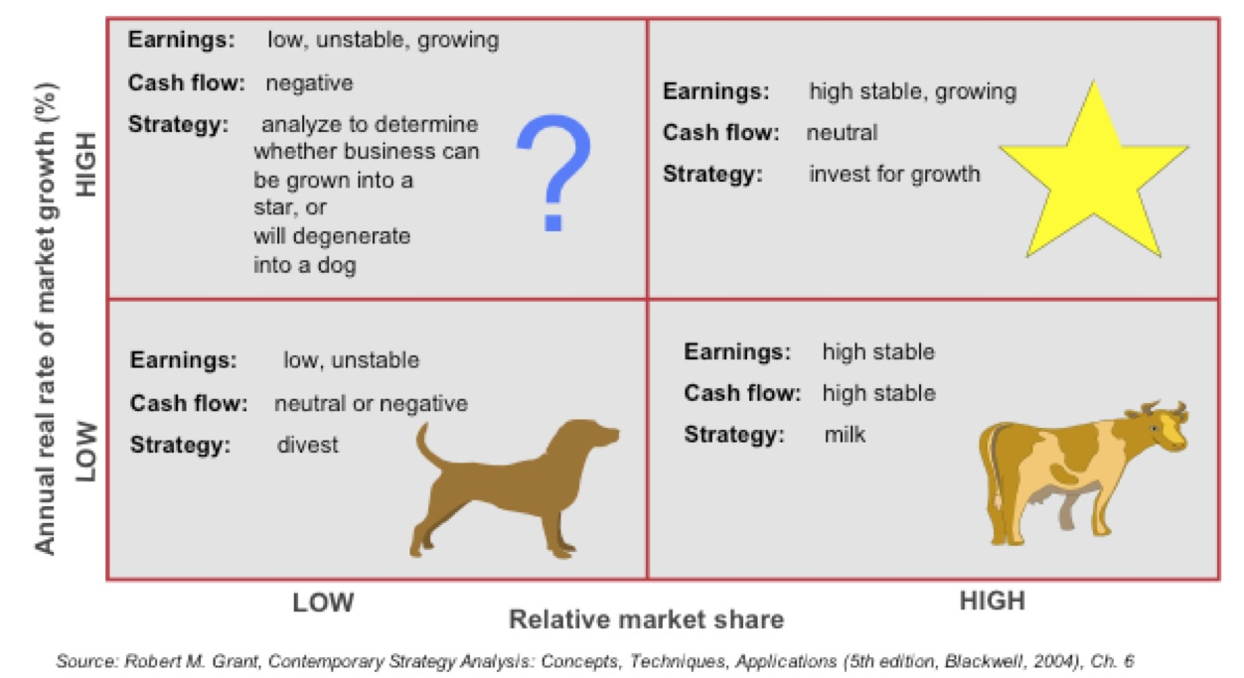
BCG MATRIX

Slide 14
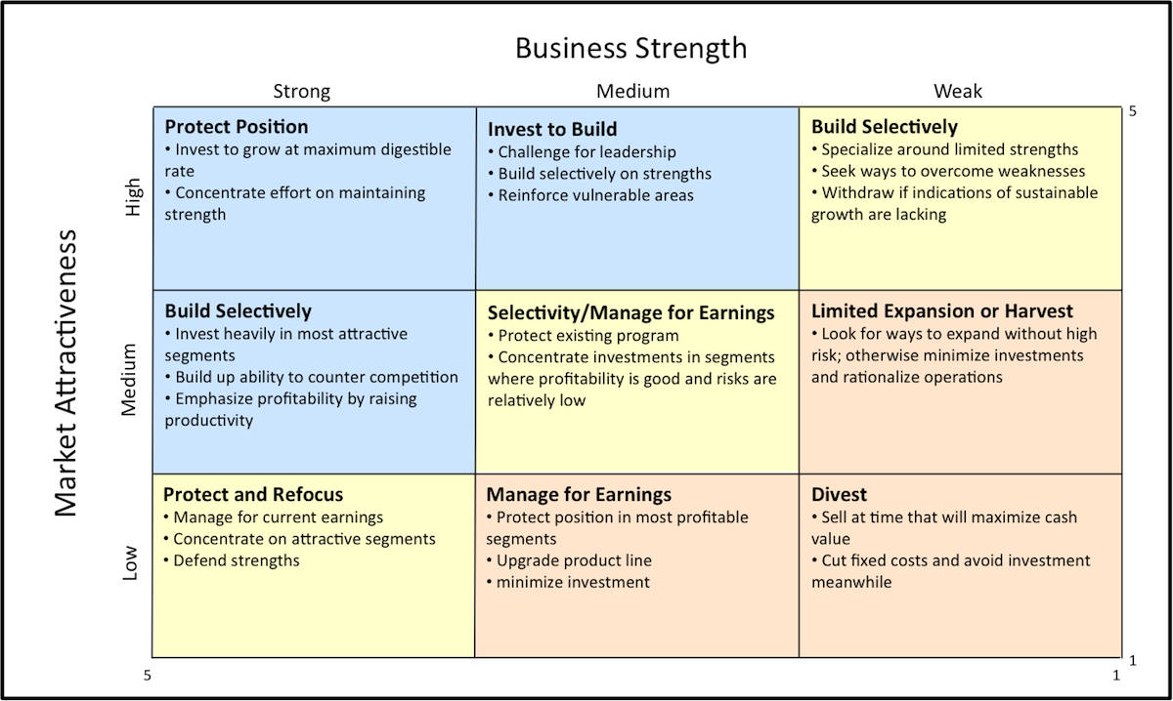
General Electric (GE/McKinsey) matrix

Slide 15
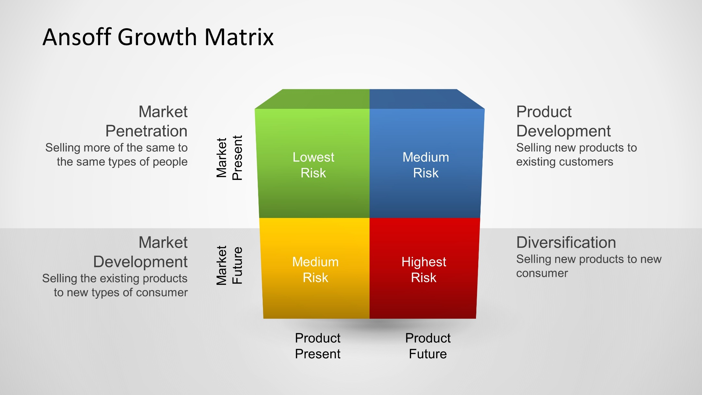
Ansoff’s Matrix

